Slide 1
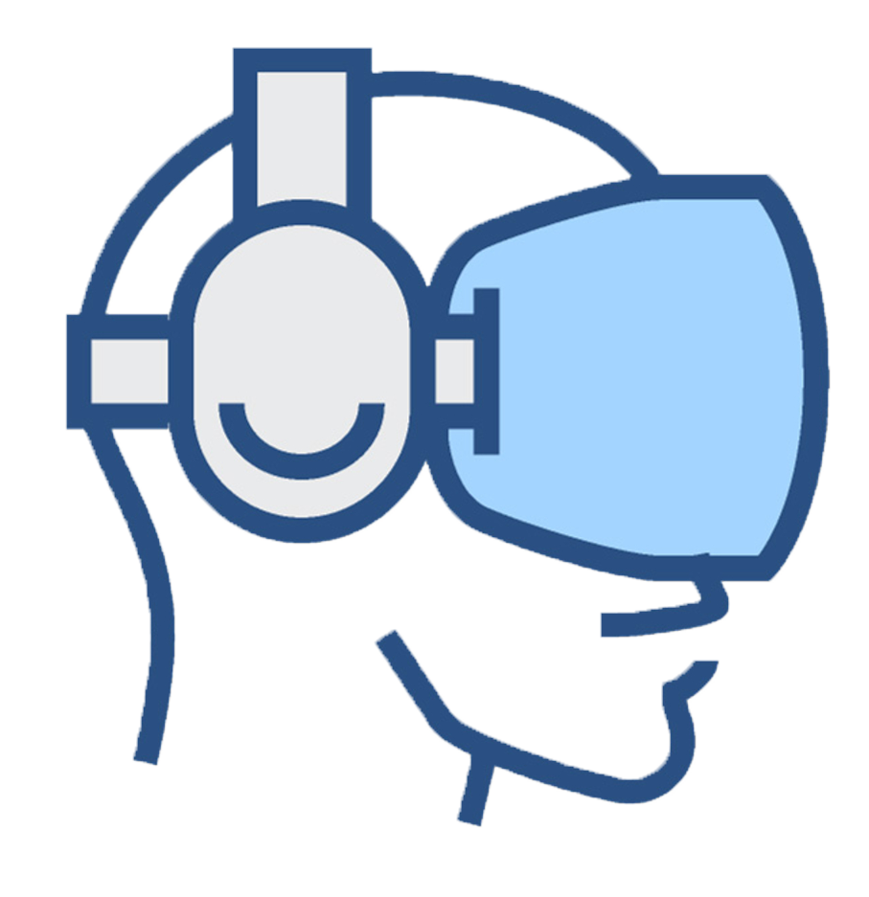
Reducing dizziness when using a video-see-through head-mounted display
Richard Segovia Barreales
9th July 2018

Slide 2
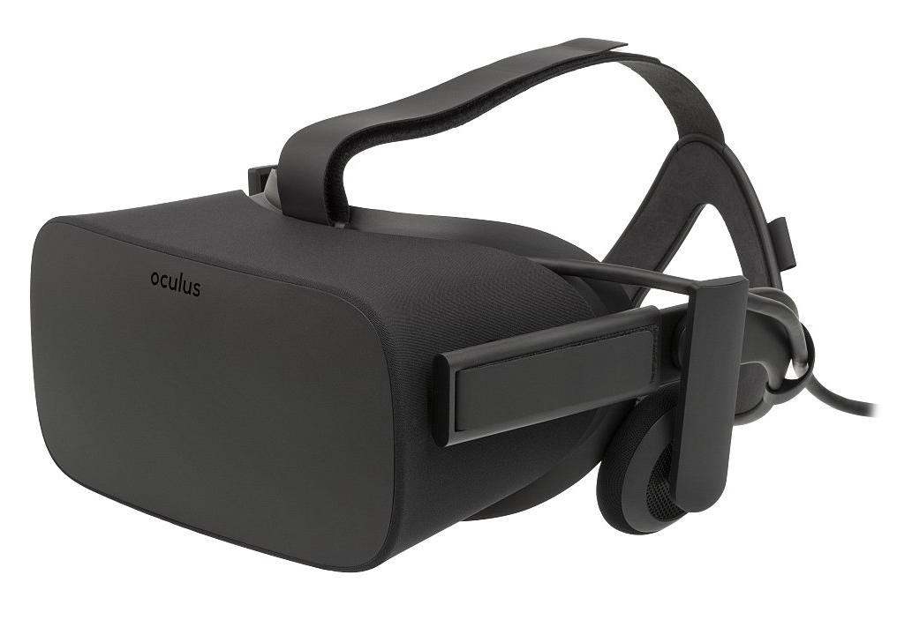
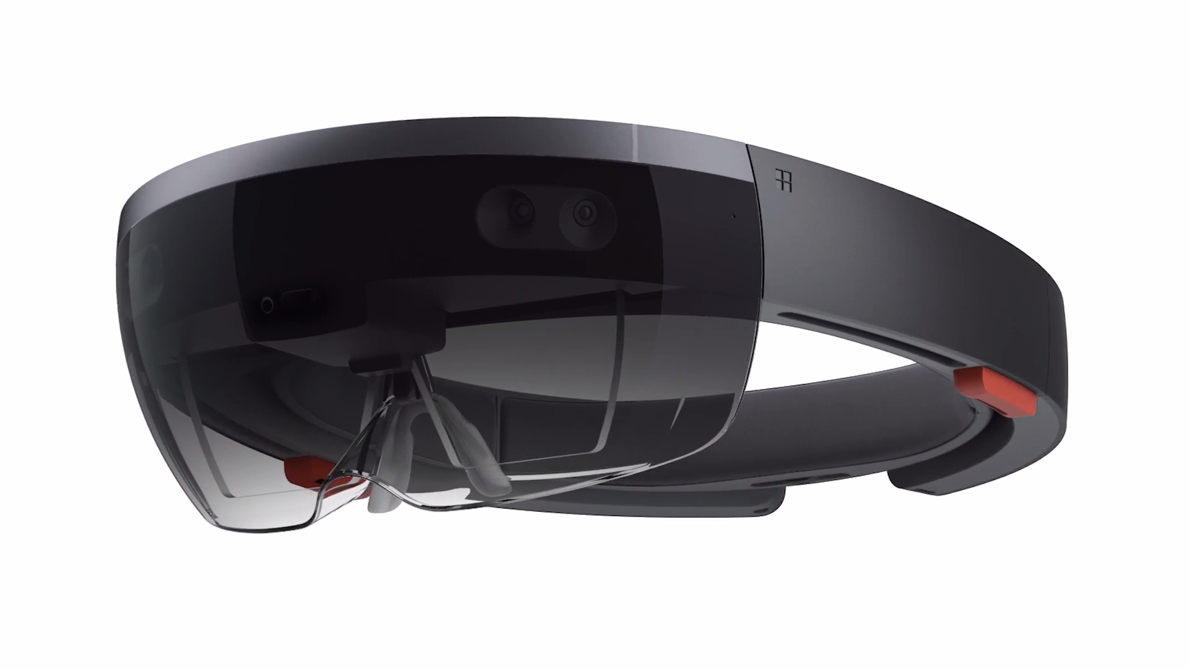
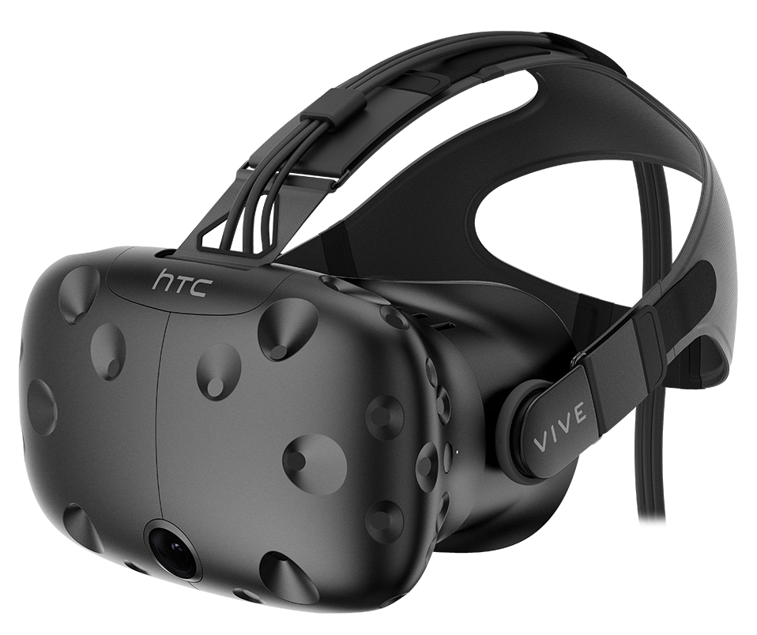
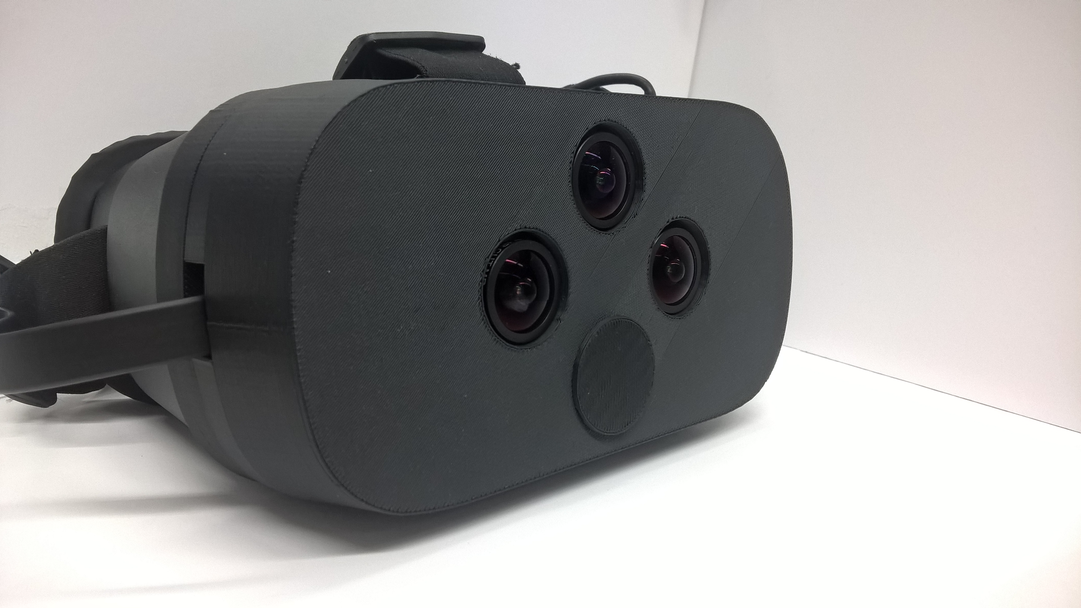
Introduction
Head Mounted Displays
Virtual Reality
See-through

Slide 3
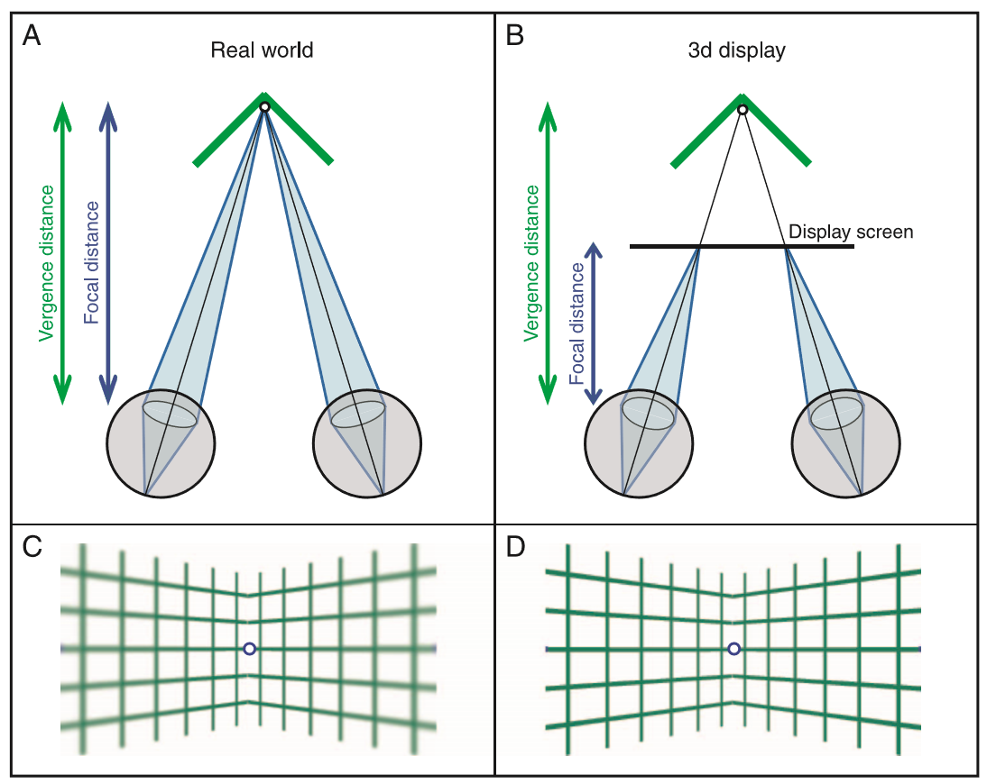
Introduction
Dizziness issue
Accomodance-Vergence conflict $^{1}$
Size issue
Gap
Eyes
Cameras
1. HOFFMAN, David M., et al. Vergence–accommodation conflicts hinder visual performance and cause visual fatigue. Journal of vision, 2008.

Slide 4
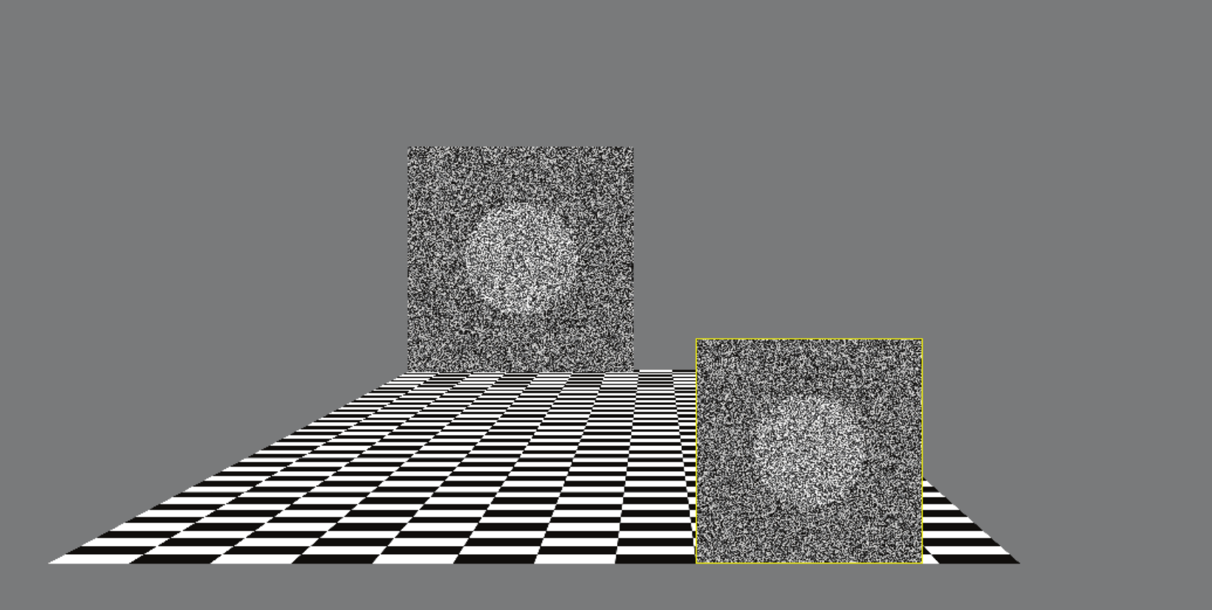


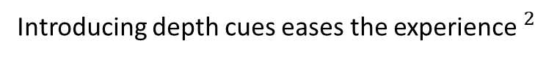
Introduction
State of the art solutions
Introducing depth cues eases the experience$^{2}$
Google’s eye tracking for optical see-through
2. POULAKOS, Steven, et al. Alternating attention in continuous stereoscopic depth. ACM, 2014.

Slide 5
Introduction
Our solution (I)
Zoom in/out
Move over the image
ROI
ROI
3 distances = 3 settings
Far
Medium
Near
Left image
Right image
Screen

Slide 6

Introduction
Our solution (II)
Zoom in/out
Move over the image
Stereo
Matcher
ROI
ROI
Change Setting
Depth
Left image
Right image
Screen

Slide 7
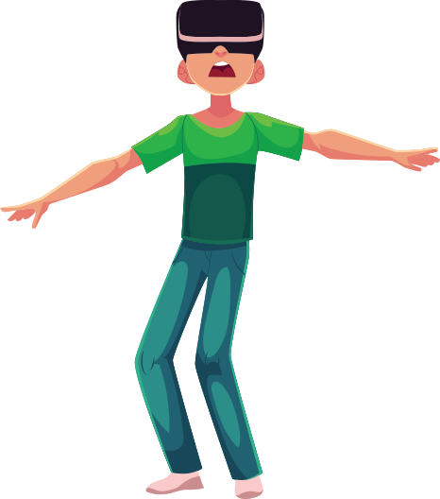
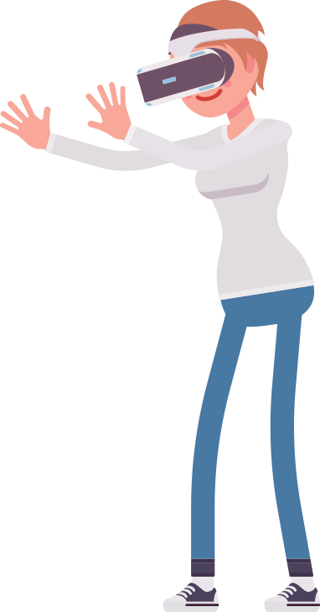
Introduction
Objectives
Evaluate the Accomodance-Vergence conflict
Evaluate the size issue
Solve the Accommodate-Vergence conflict using depth
Solve the size issue
Evaluate if our solution solves these problems
Keep the performance
Useful modules for further development

Slide 8



Development
Tools used
Graphic scene visualization
User interface
Threads
Calibration
Image processing
LIBELAS
Depth map

Slide 9
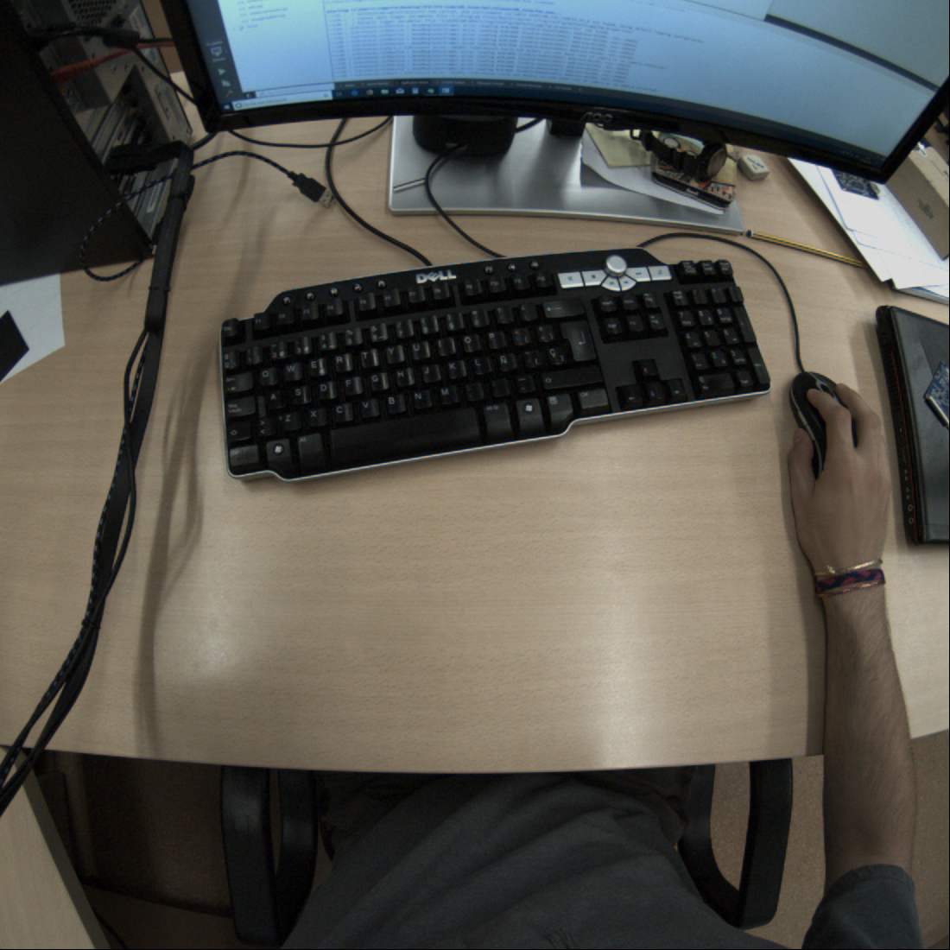
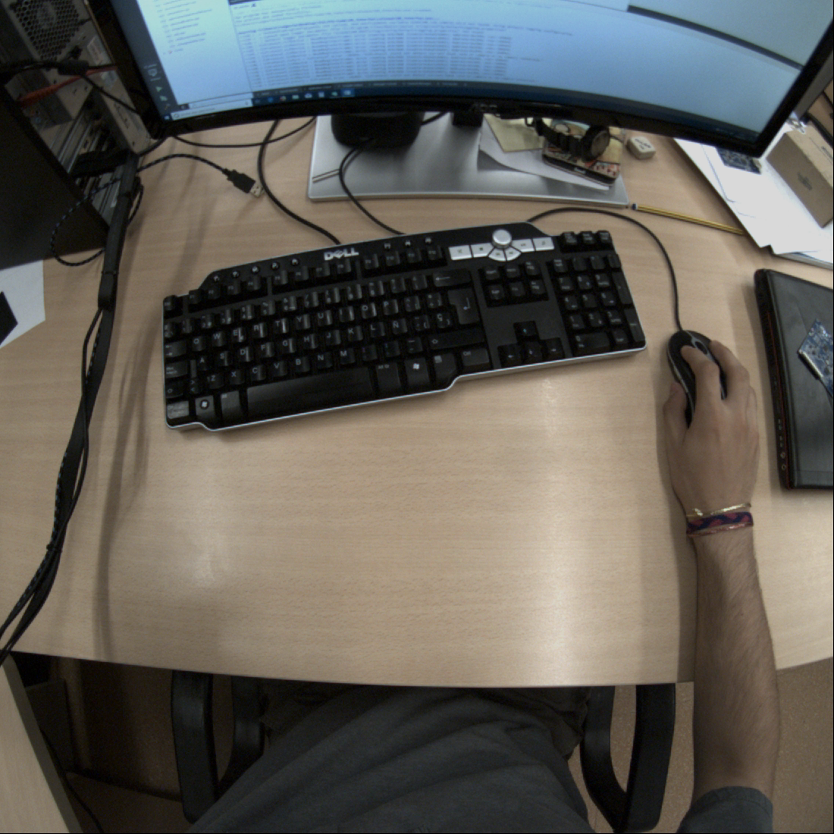
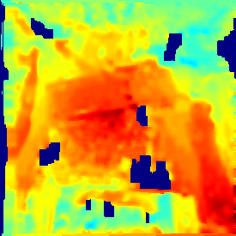
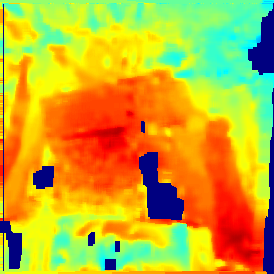
Development
LIBELAS
LIBELAS
Stereo
Matcher
Depth map

Slide 10
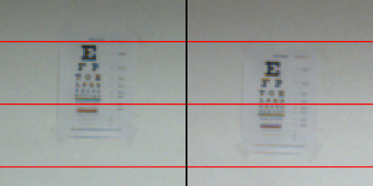
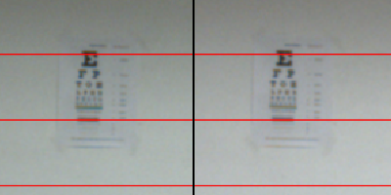
Development
LIBELAS issue (I)
Original Image
LIBELAS
Calibration
Stereo
Matcher
Depth map
Rectify
Rectified

Slide 11
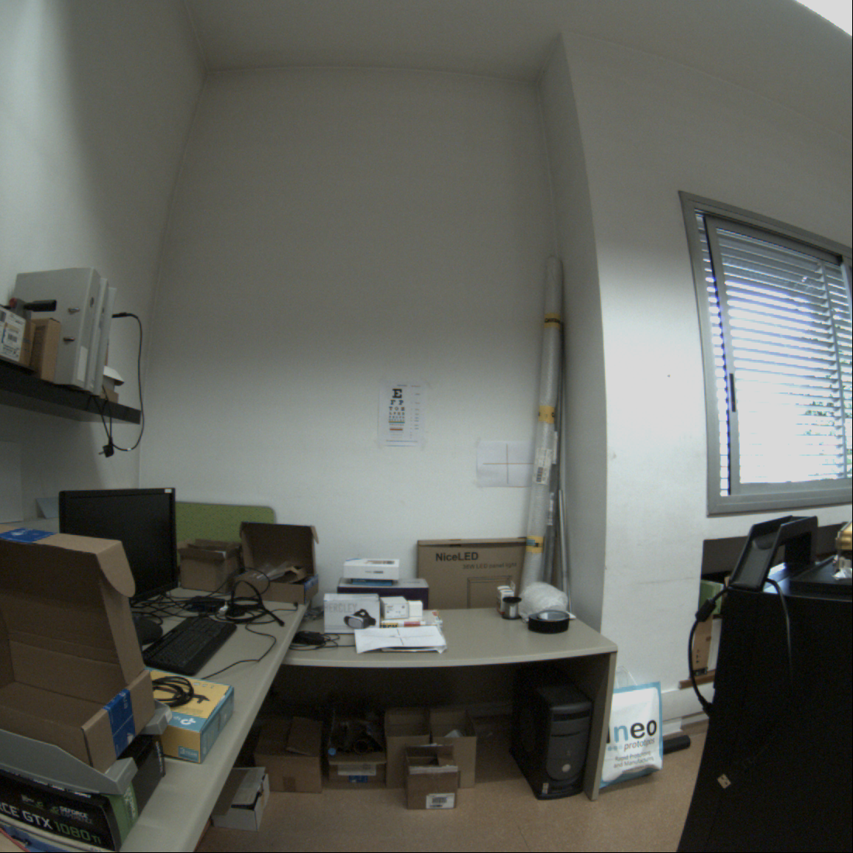
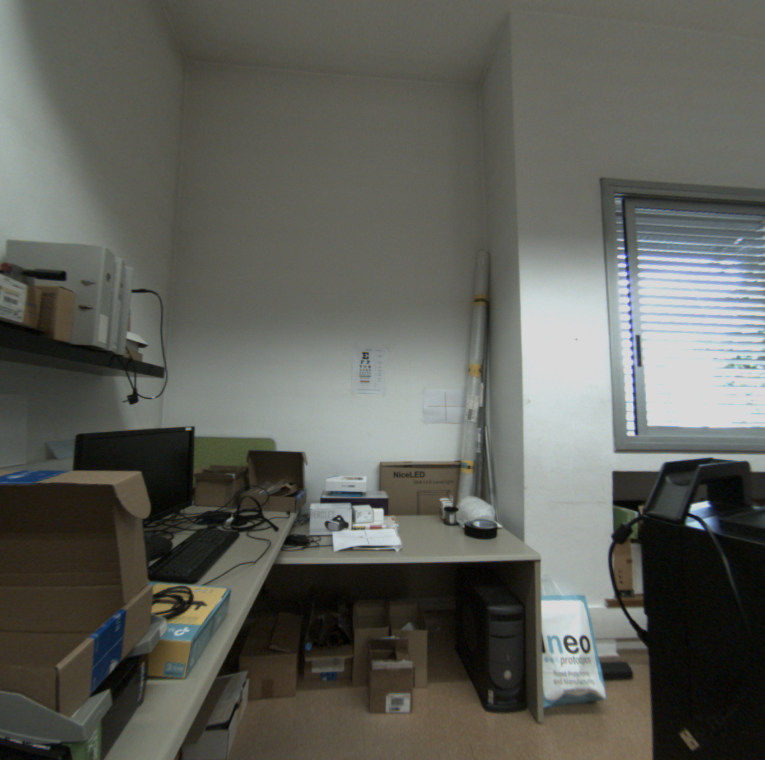
Development
LIBELAS issue (II)
Original Image
Rectified
Rectify

Slide 12
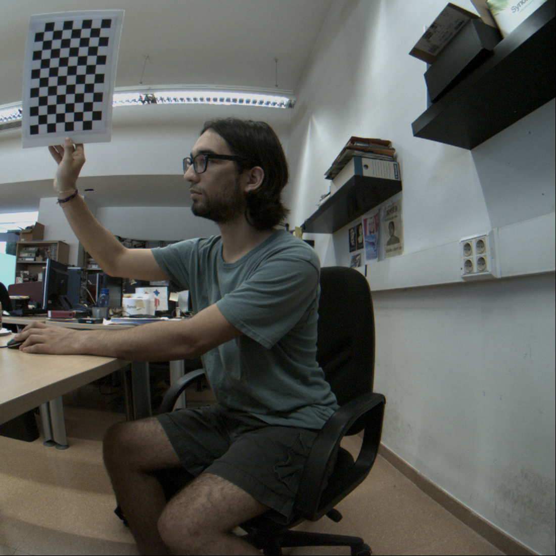
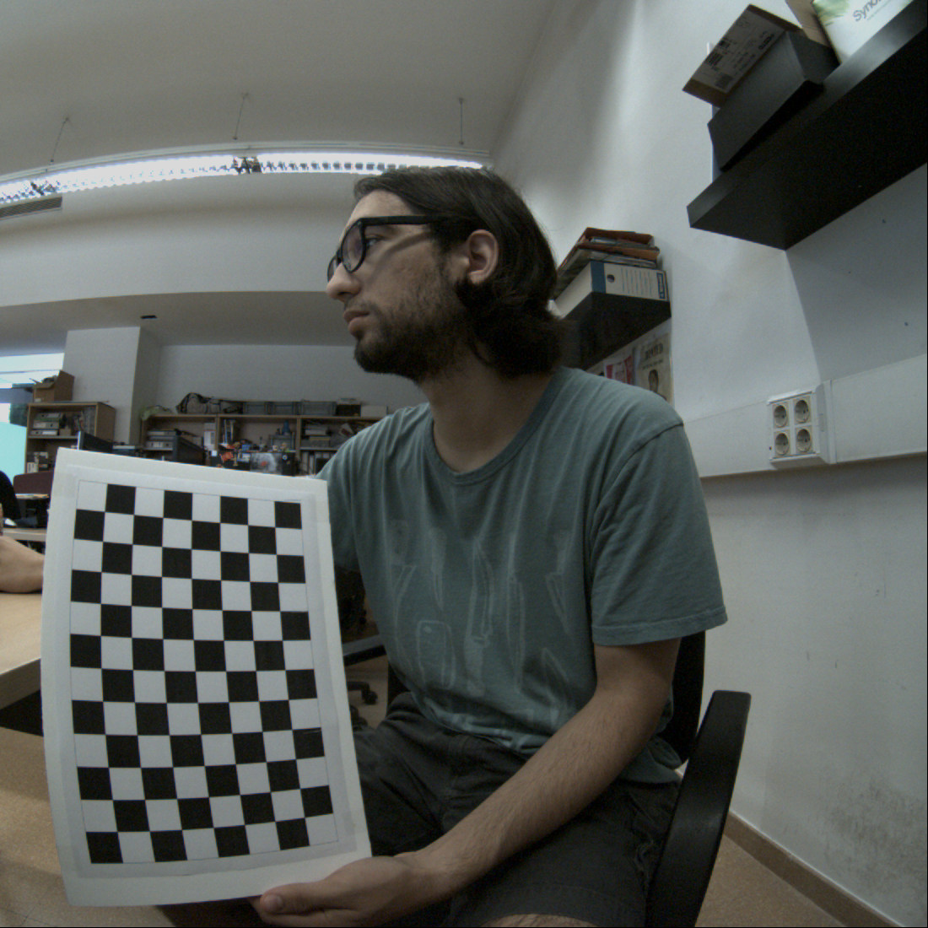
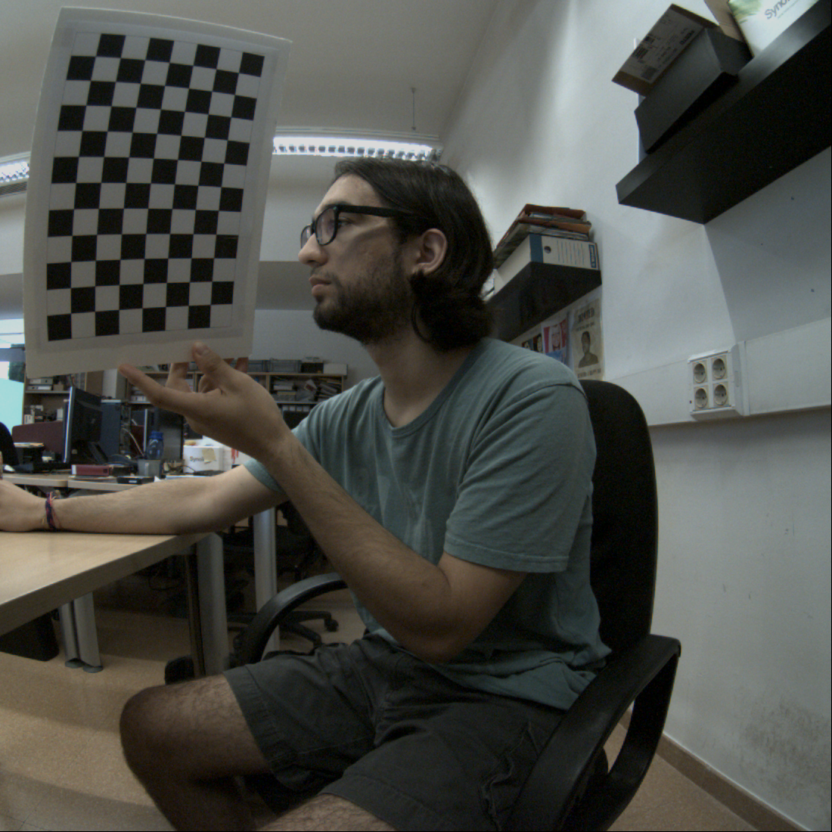
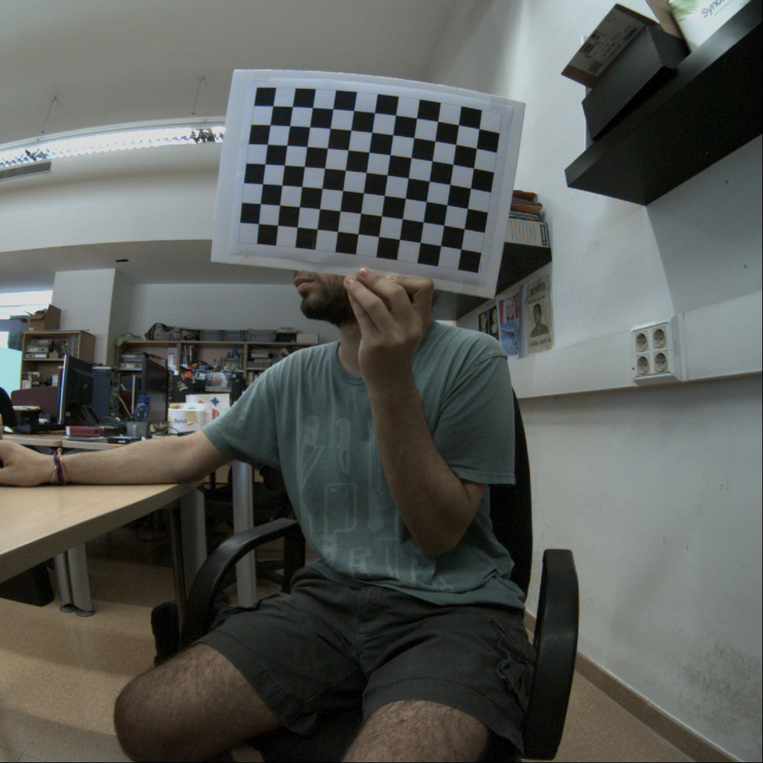
Development
Calibration module
Intrinsic matrix,
Distortion matrix …
Locate chessboard pattern
Monocular
Calibration
Stereo
Calibration
Rectify
images
Points:
(126,32), (568,952)…
Rotation matrix
Traslation matrix

Slide 13
Development
Threshold Classifier
Crop
Distance
Operation
mean/max/min
Threshold
Classification
Far
Medium
Near
Value

Slide 14
Development
Pipeline
Displaying
images
Rectify
Grabbing
image
Thread 1
ROI
Depth map
Grabbing
image
Preset
Thread 2
Distance
Classification
transition
Displaying
Processing
Thread
Thread

Slide 15
Development
Pipeline example
mean value
2.07
Far
distance
Depth map crop
Depth map
Original
Rectified
Depth color map

Slide 16
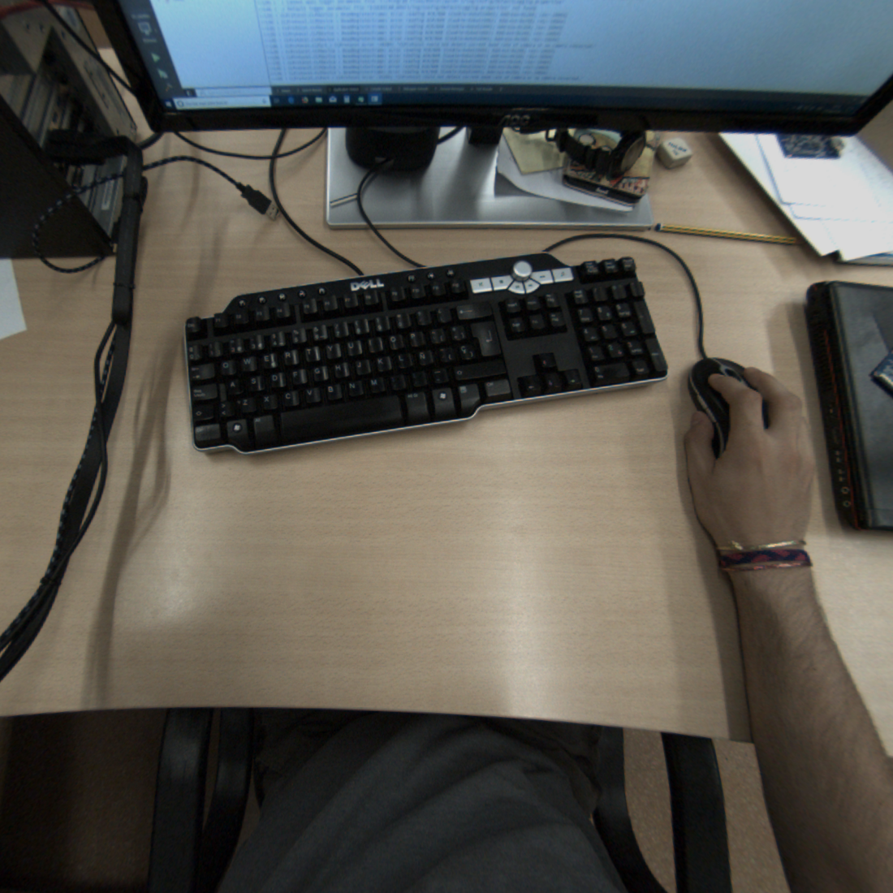
Results
Performance issues (I)
Crop the center (ROI)
Downsampling

Slide 17
Results
Performance issues (II)
Reducing the size solves the bottleneck
Original → 624 ms (1,6 fps)
Downsampling x4 → 56 ms (17,8 fps)
Downsampling x12 → 27 ms (37,8 fps)
Computing time near real time
Now rectification becomes the bottleneck
Downsampling

Slide 18

Results
Output stability
Downsampling Outputs
Cropping Outputs

Slide 19
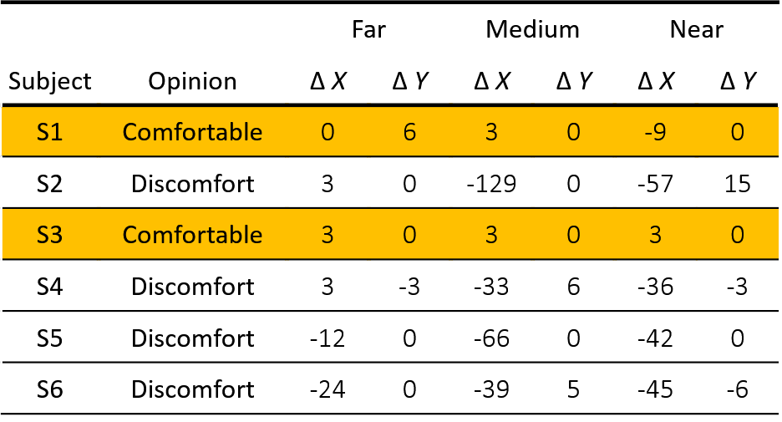
Results
First user testing (I)
 |  | Far |  | Medium |  | Near
Subject | Opinion | Δ X | Δ Y | Δ X | Δ Y | Δ X | Δ Y
S1 | Comfortable | 0 | 6 | 3 | 0 | -9 | 0
S2 | Discomfort | 3 | 0 | -129 | 0 | -57 | 15
S3 | Comfortable | 3 | 0 | 3 | 0 | 3 | 0
S4 | Discomfort | 3 | -3 | -33 | 6 | -36 | -3
S5 | Discomfort | -12 | 0 | -66 | 0 | -42 | 0
S6 | Discomfort | -24 | 0 | -39 | 5 | -45 | -6
?
Felt comfortable
Did not change the settings
Do not felt comfortable
Did change the settings

Slide 20
Results
First user testing (II)
Default setting
Centered
Huge displacement
First user testing
Second user testing

Slide 21
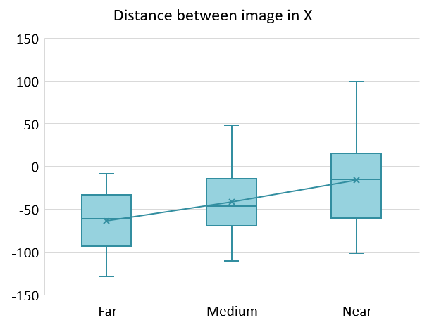
Results
Second user testing (I)

Slide 22
Results
Second user testing (II)
Cross setting positive opinion

Slide 23
Results
Second user testing (III)
With
transition
Slow
Not comfortable
Needs improvement
Dynamic settings
Users prefer to use it
Without
transition
Too sudden
Small adaptation period needed
Not induce dizziness

Slide 24
Conclusions
User testing
Users need one setting for each distance
Performance
Threaded architecture
ROI and cropping
Dynamic settings
Was successfully developed
Users prefer this over using one setting for everything

Slide 25
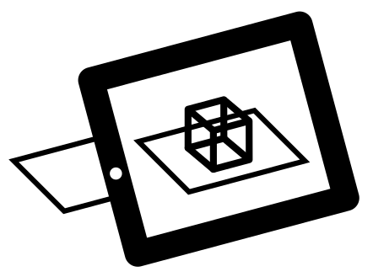

Future work
LIBELAS
Other
Stereo matchers
Vs
Augmented reality
Transition
Improve
User testing
Computing power

Slide 26

Contact info
richard.segovia@e-campus.uab.cat

